Slide 1
THE MAIZE
Saving water and energy in maize growing
Maurizio N. classe 4 sezione B IIS Garibaldi Macerata A.S. 2012-13 Project Maize

Slide 2
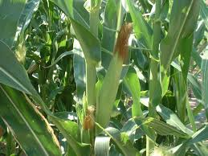
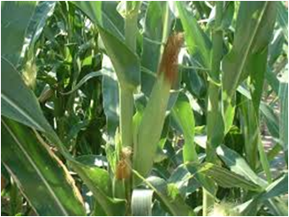
MAP
Driving question
General features
Irrigation methods
Surface Irrigation
Sprinkler irrigation
Maize
Photo gallery
Drip irrigation
Maize for new energy
Energy & maize
Maurizio N. classe 4 sezione B IIS Garibaldi Macerata A.S. 2012-13 Project Maize

Slide 3
General Features
Maize is a plant that requires the use of a lot of water because it is a spring-summer crop. It requires from 350-800 mm/ha of water. It is a plant that we find more in the north because there is a greater amount of water available.
Maurizio N. classe 4 sezione B IIS Garibaldi Macerata A.S. 2012-13 Project Maize

Slide 4
General Features
Maize is a plant that can become 3 metres high.
The production of maize is about 120-150 tons per hectare.
Maurizio N. classe 4 sezione B IIS Garibaldi Macerata A.S. 2012-13 Project Maize

Slide 5
Irrigation methods
To irrigate the maize we have three methods: scrolling, sprinkling and drip. The best is to drip because it is the one with which you use less water.
Maurizio N. classe 4 sezione B IIS Garibaldi Macerata A.S. 2012-13 Project Maize

Slide 6
Surface irrigation
The surface irrigation is the method that serves the greater amount of water as it has to cover the whole ground. With this method, the water evaporates, so there is an excessive consumption of water.
Maurizio N. classe 4 sezione B IIS Garibaldi Macerata A.S. 2012-13 Project Maize

Slide 7
Sprinkler irrigation
The sprinkler irrigation is more convenient than scrolling. This method consists in spreading with a water jet, in the form of very small droplets.
Maurizio N. classe 4 sezione B IIS Garibaldi Macerata A.S. 2012-13 Project Maize

Slide 8
Drip irrigation
The drip irrigation and the most convenient method to save water and energy because the right amount of water to the plant. This method is very simple and consists in arranging the tubes drilled between the rows of maize.
Maurizio N. classe 4 sezione B IIS Garibaldi Macerata A.S. 2012-13 Project Maize

Slide 9
Energy & maize
Maize is a plant that does not consume energy but produces it. For example, to produce energy, irrigation canals can be installed mini-plants that produce clean electricity due to the water flow. The energy can be sold or used for corporate needs.
Maurizio N. classe 4 sezione B IIS Garibaldi Macerata A.S. 2012-13 Project Maize

Slide 10
Maize for new energy
The maize in recent years has been widely used not to take the beans, but “trinciarlo” for use in power plants and biogas. The maize in these plants is one of the main materials.
Maurizio N. classe 4 sezione B IIS Garibaldi Macerata A.S. 2012-13 Project Maize

Slide 11
Driving question
Saving water and energy in maize growing is possible nowadays. In order to waste less water we have to use drip irrigation method, so as to increase the production, which will allow these biogas plant to thrive.
Maurizio N. classe 4 sezione B IIS Garibaldi Macerata A.S. 2012-13 Project Maize

Slide 12
Bibliography
http://www.agraria.org/coltivazionierbacee/mais.htm http://www.netafim.it/article/irrigazione-a-goccia-del-mais http://www.netafim.it/crop/corn
Maurizio N. classe 4 sezione B IIS Garibaldi Macerata A.S. 2012-13 Project Maize

Slide 13
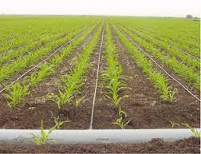
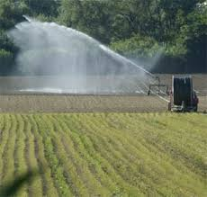
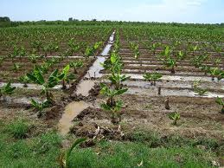
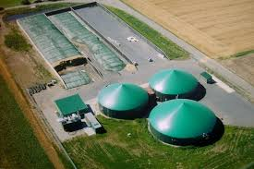
Photo gallery
Maurizio N. classe 4 sezione B IIS Garibaldi Macerata A.S. 2012-13 Project Maize

Slide 14
Drip irrigation
Maurizio N. classe 4 sezione B IIS Garibaldi Macerata A.S. 2012-13 Project Maize

Slide 15
Sprinkler irrigation
Maurizio N. classe 4 sezione B IIS Garibaldi Macerata A.S. 2012-13 Project Maize

Slide 16
Surface irrigation
Maurizio N. classe 4 sezione B IIS Garibaldi Macerata A.S. 2012-13 Project Maize

Slide 17
Biogas Plant
Maurizio N. classe 4 sezione B IIS Garibaldi Macerata A.S. 2012-13 Project Maize

Slide 18
Thank you for your attention
Maurizio N. classe 4 sezione B IIS Garibaldi Macerata A.S. 2012-13 Project Maize

