Slide 1
Saving water and energy in vinification
What are the technique to save water and energy in the production of wine? And how much do you save?

Slide 2
Techniques for saving water
Technique: Solutions for saving water in washing operations
Technique: Solutions for reducing wastewater from washing
Technique: Systems and technologies for water treatment and reuse
Technique: Solutions for the reduction of water consumption in the early stages of the process
Technique: Solutions for the reduction of water consumption in the early stages of bottle washing

Slide 3
Map
Solutions for the reduction of water consumption in the early stages of the process
Solutions for the reduction of water consumption in the early stages of bottle washing
Techniques for saving water
Solutions for saving water in washing operations
Systems and technologies for water treatment and reuse
Solutions for reducing wastewater from washing

Slide 4
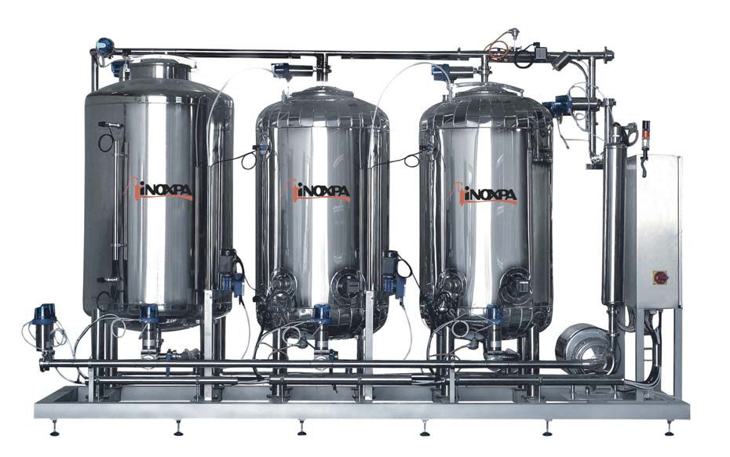
Solutions for saving water in washing operations: CIP systems (Cleaning in Place)
The Clean In Place (CIP) is an automatic cleaning system, embedded in the equipment to be cleaned, which achieves a circulation under certain pressures and / or temperatures, liquid detergents and rinsing solutions. This washing system is used to ensure that the production lines are purified from organic and inorganic contaminants. CIP allows you to use water and detergent in the quantities strictly necessary and, therefore, to avoid waste; often also have water purification systems, by sedimentation and ultrafiltration, functional reuse of cleaning solutions, which are for example used for pre-rinsing equipment.

Slide 5
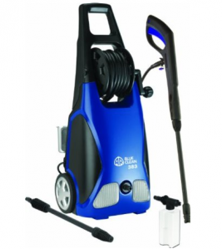
Medium Pressure Washers
The cleaning systems hydraulic medium pressure ensures a greater cleaning efficiency and a considerable saving of water (eg. pressure washers that consume 60 l / min of water at 1.5 MPa damage cleaning efficacy equal to pressure washer operating at 0.3 MPa which consumes 250 l / min). This reduces the consumption of water and the volumes of wastewater to be treated. And if you use hot water you'll save a proportional energy needed for heating.

Slide 6
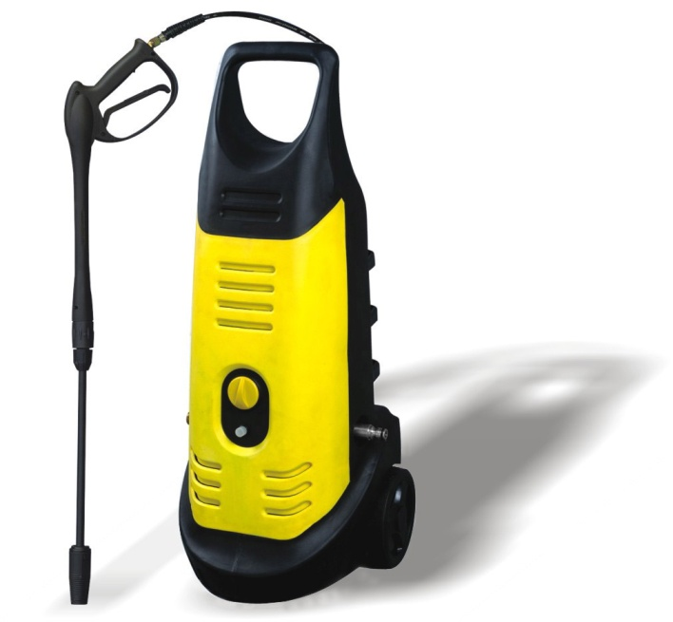
High pressure washing (HPLV)
In the high-pressure washing and low volume water is sprayed at a pressure that, starting from 15 bars may even reach 150 bar, with average values ​​of 40 - 65 bar. The mechanical action of the water pressure allows to considerably reduce, with equal effectiveness of cleaning, the wash water temperature (and therefore the energy needed to heat) as well as the use of sanitizing products. The same water consumption is very limited.

Slide 7
Solutions for reducing wastewater from washing: Use of compressed air for removing residues
It is a technique compatible with the dry washing. Quality compressed air feed can be used to remove from piping and machinery residues after the processing cycle, allowing to reduce the consumption of water for washing and especially improving the quality of wastewater. Thanks to this technique is also reduced the amount of waste generated during the change between two different productions.

Slide 8
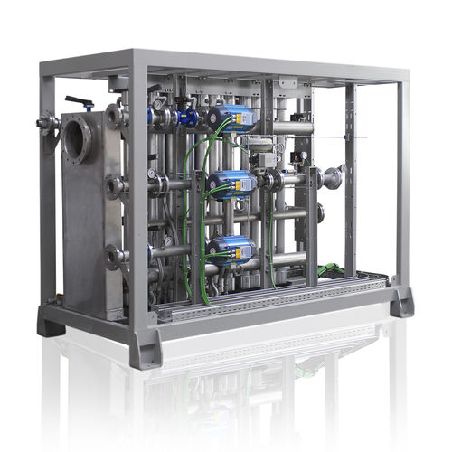
Systems and technologies for water treatment and reuse: Membrane systems
Membrane technology has become a competitive separation technology over the past decades. This technology does not require the addition of chemicals and is moderately energy-consuming. The process of separation of the membrane is based on the presence of semi-permeable membranes. The principle is quite simple: the membrane acts as a very specific filter that lets water through, while retaining suspended solids and other substances. The membranes behave as a selective separation wall. Some substances can pass through the membrane, while other substances are captured.

Slide 9
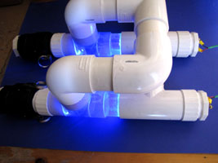
UV radiation
The radiation emitted from the UV lamps are absorbed by the bacterial cell walls causing a photochemical reaction and damaging the process of reproduction of microorganisms, along with many bacteria pathogenic organisms (eg viruses) are extremely sensitive to this type of radiation. the advantages of UV disinfection of water for reuse are:
does not alter the color, smell, taste, or pH of the water;
does not require the addition of chemical agents;
does not enter toxic byproducts in the water;
UV systems are compact and easy to install;
UV systems require very little labor;
energy costs of operation are often lower than those of a light bulb.

Slide 10
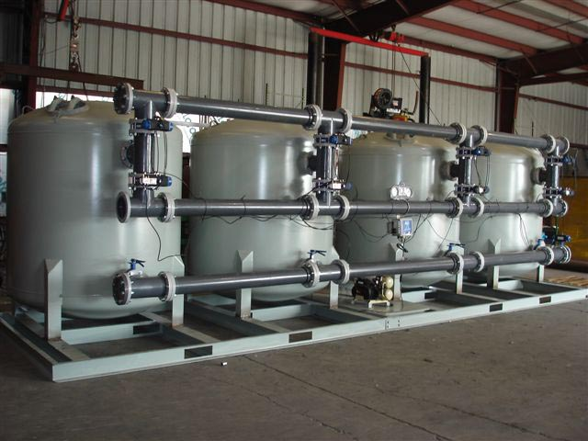
Recycling of wash water
Recirculation unit can be installed for reuse, after appropriate purification, for the same or for other purposes, the washing water of the production departments, achieving benefits in terms of reduction in the consumption of water and the final volume of discharges issued in 'environment. The energy required to the phases of recirculation and purification are in several cases offset by the reduced need for thermal energy consumption for heating of water, previously heated to the previous washing, is characterized by higher temperatures.

Slide 11
Solutions for the reduction of water consumption in the early stages of the process: Flow regulators
The flow valves can be used in manual or automatic systems: they do provide a constant flow within a certain range of flow. Proved to be very valuable especially in cooking operations where any excess water inlet is also a waste of energy needed to heat the water in abundance. The presence of flow valves also has a meaning of education and training for the staff and allows them greater involvement in the overall program to reduce the consumption of water.

Slide 12
Using injectors
The use of injectors is fairly widespread in the food industry for different uses of which the washing or cooling of the product and the cleaning of the machinery are the most important . Through a proper positioning and orientation of the injectors on the product or on the object on which the water jet must act and , especially , in the presence of control units thanks to the pressure of the water , may allow a significant reduction of water consumption .

Slide 13
Plumbing -waste
The taps may be , in the food industry in general, a substantial source of water consumption , particularly applied to hoses used for washing facilities and departments. Traditional models are characterized by large flows of water , also may be left open even when not used . There are models whose flow allows a saving of water, also up to 80%

Slide 14
Solutions for the reduction of water consumption in the early stages of bottle washing: multistage system sanitizing bottles
The sanitization multistage for bottles encloses in a single wash system different methods of sanitizing and exploits in a synergetic way the use of hot water, chemicals and mechanical cleaning mechanisms. the initial wash and the caustic bath have the main aim of disinfecting the bottles, while the removal of particles, salts of calcium and magnesium and residues of chemical products is made ​​in the subsequent phases. The most amounts advantages of this technology are related to the reduction of water consumption and chemicals with everything involving including storage, use and contamination of wastewater. In this case also the pH of the wastewater is optimized thanks to the neutralization. Are also reduced energy consumption including not least those necessary to the treatment of wastewater.

Slide 15
Reuse of the wash solution of the bottles
To save water and caustic soda and to avoid excessive increase the pollution load of wastewater, the bathroom washing the bottles can be pumped into a settling tank in which realizes the separation of the particles contaminants, which are then sorted before using the solution for a new wash. The sedimentation tank also serves as a temporary storage unit. Such technology allows on one hand a water-saving and chemical reagents, as well as an improvement of the discharge liquid, but it involves an increase in the energy consumption of the process in relation to the operation of the pumps and of the filtering system which treat the rinse water.

Slide 16
Reusing water bottles pasteurization
At times of peak production the need for volumes of water for cooling in the process of pasteurization may be larger than the actual possibilities of the system to provide them . In these cases, often the water used for cooling is directly discharged into the sewer with a considerable waste of water and of substancesTo limit these chemicals then you can proceed to a waste water reuse in more than collected in stainless steel tanks , then is conveyed to the cooling systems (eg, cooling towers ) that carry them in the thermal conditions allow a functional new use , after addition of corrosion inhibitors and biocides.With this technology it is possible to reuse a significant reduction in water consumption is that the volumes and quality of water discharges . This system is applicable to the pasteurizer and vacuum pumps

Slide 17
bibliography
http://img.directindustry.it/images_di/photo-g/impianti-cleaning-in-place-cip-industria-alimentare-66392-2562741.jpg
http://pwr.jrk.netdna-cdn.com/wp-content/uploads/2013/08/AR383-1900PSI-Electric-Pressure-Washer-267x300.png
http://img.diytrade.com/cdimg/165685/394749/0/1121170471.jpg
http://img.directindustry.com/images_di/photo-mg/membrane-nitrogen-gas-generators-31463-2466833.jpg
http://www.biophysica.com/FCK_UPLOADS/electrodesCuAg.jpg
http://www.washbaysolutions.com/wp-content/uploads/2010/10/4-vessel-Filter-System.jpg

Slide 18
Thanks for your attention

